Slide 1
Project Management Overview

Slide 2
Purpose of the chapter
Define a project
Define project success
Project constraints
Project management expertise
The project environment
Project management knowledge and skills

Slide 3
Define a project
Define a project:
Unique product or service
Time-limited
Project ends when the objectives are achieved or abandoned

Slide 4
Unique
How can you tell that an activity is unique?
Completely new product or service
Creation of new process
Product or service new to this group of people

Slide 5
Time-limited
May have a start and end date
May be measured as “will be complete when a particular objective is achieved”
If it simply continues forever or to an unspecified end-date it is probably an ongoing business activity

Slide 6
Can tell when it is done
Objective is achieved
Time limit is reached
Objective is abandoned

Slide 7
Project Success
Traditionally: on time, within budget and delivers the promised scope
More effective measure: satisfied customer

Slide 8
Group work
In small groups, try to identify the LARGEST project each of you have been involved with.
You do not have to have been the project manager—if not, what was your role? (team member, volunteer, purchaser, ??)
With the group, make it clear how the project you have identified meets the criteria:
Unique
Temporary

Slide 9
Project constraints
Cost
Scope
Quality
Risk
Resources
Time

Slide 10
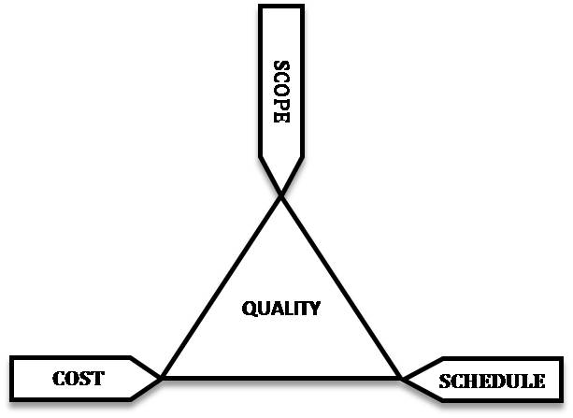
Triple constraint
All the constraints can be grouped into these three:
The triad constraints by John M. Kennedy T. (http://commons.wikimedia.org/wiki/File:The_triad_constraints.jpg) used under CC-BY-SA license (https://creativecommons.org/licenses/by-sa/3.0/)

Slide 11
Project Management Expertise
Application knowledge
Industry group
Technical specialty
Managerial area
Understanding the project environment
Cultural, social, political, international, physical
Management knowledge and skills
Interpersonal skills
Communication, influence, leadership, motivation, negotiation and problem solving

Slide 12
Project Management Standards
Standards organizations
PMI
Project Management Institute: http://www.pmi.org/
CAPM, PMP and other professional standards
IPMA
International Project Management Association: http://ipma.ch/
Several certifications

Slide 13
Summary
Project definition: unique, time-limited, can tell when it is over
Project success: satisfied client
Project constraints: time, scope, cost
Project management expertise
The project environment
Project management knowledge and skills

Slide 14
Questions?

